Slide 1
Hough Transform
Digital Image Processing
In-class Exercise 12
Shwet Shah (800904562)

Slide 2
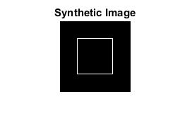
synthetic image

Slide 3
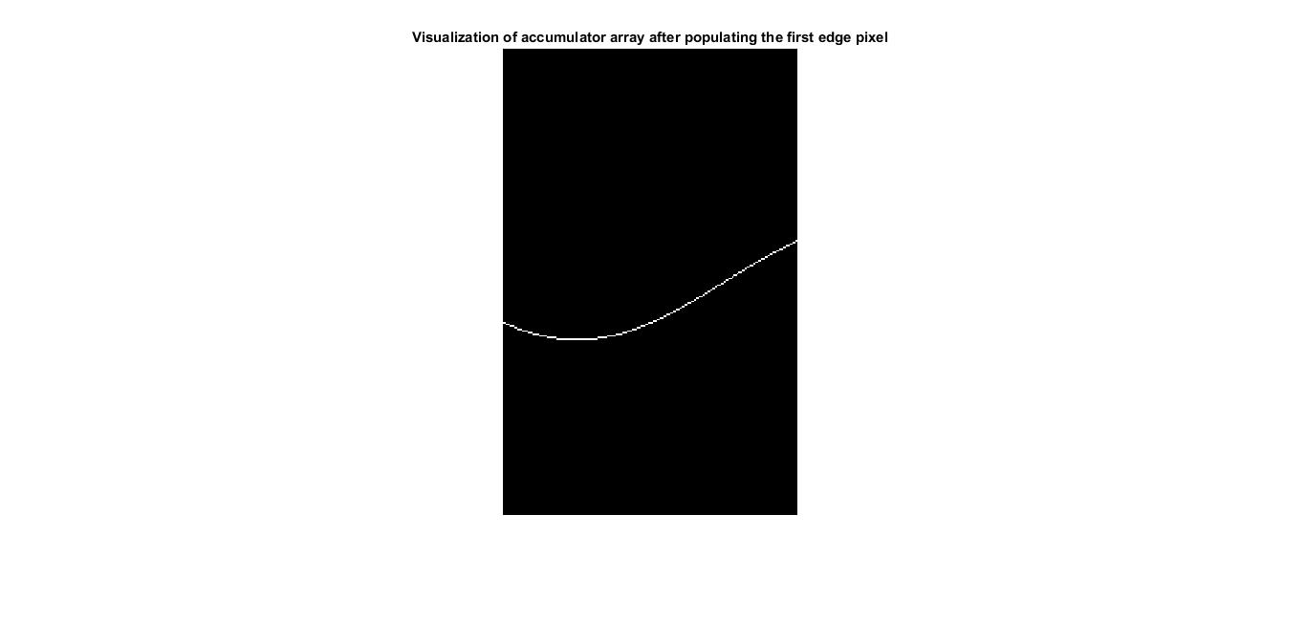
accumulator array visualization with first edge pixel

Slide 4
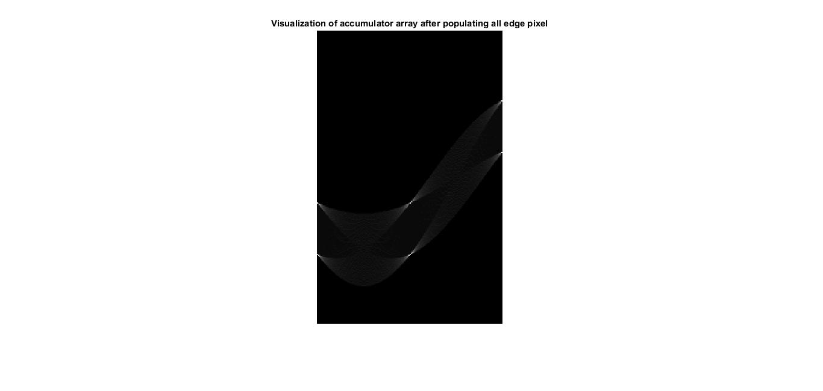
accumulator array visualization with all edge pixel

Slide 5
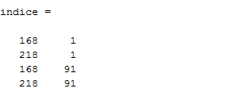
locations in accumulator array with highest votes

Slide 6
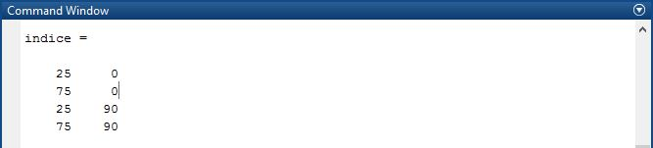
conversions to the theta and rho of places with highest votes

